Slide 1
CSP2348/CSP5243 Data Structures
Lecture 01
Introduction to the unit

Slide 2
General Information (1)
Staff contact details
Dr Jitian XIAO
Unit coordinator, lecturer & tutor
Office: Room ML 13.236
Email: j.xiao@ecu.edu.au
Tel: 6304 6056
Further information

Slide 3
General Information (2)
Unit Content:
Algorithms: principles and analysis of algorithms; the notion of complexity of algorithms; recursive algorithms and their complexity.
Data structures (arrays, linked lists, binary trees, and hash tables): general properties; specific properties in Java; algorithms in insertion, deletion, searching, merging, and sorting, etc., on these data structures.
Fundamentals of abstract data types (ADTs): distinction between data types and ADTs; design considerations of ADTs; ADTs and software reusability; ADTs in Java Collection.
Commonly used ADTs (Stacks, Queues, Lists, Sets, Maps): their concepts and applications; design requirements; their implementation using alternative data structures; existing implementation in the Java classes.
Intro. to graph theory & graph algorithm
3
Notes:
CSP2348/CSP5243 is an required unit for the major of Computer Science. - Students who wish to be good programmers must learn this unit; those whose are good at programming will like it; those who want to do IT as s career will find it interesting and challenging; those who don’t like programming and have no interests in maths will find it hard.

Slide 4
General Information (3)
Pre-requisites
CSP1150 Programming Principles
Should have passed CSP1150 (or previously failed but enrolled simultaneously this semester)
Basic concepts of O-O programming
data types, objects, classes, methods & invocation
Basic skills of designing and implementing simple Java programs
Control statements: if, for, while, do-while, etc.

Slide 5
General Information (3)
Teaching materials are online on Blackboard.
Textbook
Data Structures & Algorithms in JAVA, by Michael T. Goodrich & Roberto Tamassia
Important Reference Textbook
Java Collections– An Introduction to Abstract Data Types, Data Structures, and Algorithms, by David A. Watt & Deryck F. Brown
Open-book exam
– You can take one of the above texts into the exam room!

Slide 6
General Information (4)
About Lectures and tutorials
Focus on understanding principles, rather than programming skills.
Learn generic analytical skills in algorithm analysis.
Learn generic decision-making skills on choosing best data structure/s for software/system development.
Require basic skills of writing simple Java code.
Tutorials and review questions cover 90% of the lecture coverage - essentials of the final exam.

Slide 7
General Information (5)
Assessments
A1: two short in-class tests (2 x 10%)
One hour in workshop session, in week 4 & 7
Similar to questions in tutorial and review questions
A2: one programming assignment (20%)
Programming using key data structures and ADTs
Final exam (60%)
Restricted Open Book – Textbook ONLY
90% questions similar to lectures, tutorials and review questions
10% advanced questions from references and other sources

Slide 8
General Information (6)
Rules for the 2 short in-class tests
Textbook, lecture notes and notebooks can be brought into the test class and consulted with during the test. However, no discussion between students is allowed during the test. Question sheet must be returned to the tutor when you finish your test.
If you are not able to attend the scheduled test/s, you may seek permission from your tutor in advance with proof for taking supplementary test.
ES students only: set up a time slot to do the test in week 04 and 07, agreed between student and tutor

Slide 9
General Information (7)
Unit Structure
Algorithms Analysis (20%)
Abstract Data Types and Design (20%)
Data Structures in Java (30%)
Java Abstract Data Types (30%)

Slide 10
General Information (8)
Study Guide
Must read your textbook
Only attending the class is not enough
Pre-lecture reading – bring your questions into class
Post-lecture reading – review and link the contents together
Reading ensures you know where to find answers to exam questions
3-6 extra hours study in a week

Slide 11
General Information (9)
Study Guide (cont…)
Do all the tutorial exercises
Attempt all review questions
Don’t miss tests
Do your best for your A2
A mini programming project using specific data structures

Slide 12
DON’T BE PANIC!
You should pass this unit if you
Attend the lectures/tutorials regularly;
Often read your textbook/s;
Treat your tutorials and review questions seriously;
Make effort to your assignments
Are not going to miss the unit review.
You will feel more confident after the first 3 weeks!

Slide 13
Contact Lecturer/tutor
Any concerns: should talk to your tutor in the first instance so that we can work together towards a suitable solution.
Don’t wait until it’s too late.
Email your tutor at anytime and he will make every attempt to deal with the problem/concern as soon as possible. May set up subsequent meetings if needed.
Email: Please put the unit code, e.g., CSP2348, in the Subject line; and your name in body of the message
Phone call: leave message, together with your name, student No., unit code, and the subject issue you are querying about
Personal problem: See the lecturer (if you feel it is something that you can discuss with him) or the Student Counselor.

Slide 14
Re Extensions to Assignments
Extensions will only be considered where supporting document/evidence is provided
√ Medical Certificate, Notes from Student Counselor
✗ Work, Travel and assignments of other unit/s are not grounds for extensions
If Assignment Extension granted, maximum 5 days (within unit-coordinator’s capacity)
Rules for extensions can be found at http://www.ecu.edu.au/student/assignment/index.php#extensions

Slide 15
Etiquette
Turn off your mobile phone or make it silent
NOTE: if you have a special reason that you need to leave the phone on, please let you lecturer know at the beginning of the lecture
MOBILE TELEPHONES AND PAGERS (FROM ECU STUDENT HANDBOOK)
Although students may take mobile telephones into libraries, lecture rooms, and tutorial rooms, as a courtesy to other students, they must ensure that the devices are switched off and not able to cause disruption to classes, or to other students attempting to pursue their studies. Mobile telephones and pagers are not permitted in examination rooms to ensure security and the integrity of the university examination.

Slide 16
Consultation time
Free consultation time
Tuesday 14:30 – 16:30
Wednesday 10:30 – 12:30
Thursday 15:00 – 17:00
Other time possible, but only by appointment via email
To avoid disappointment, email to make appointment beforehand.

Slide 17
Occupational Safety & Health
Take note of the exit points in case of Emergency
Read through the slides again on Occupational Safety & Health
(Full slides are attached to the end of this lecture)
Alarms, Warning, Evacuation
❖ Assembly points
Lab safety
❖ Enclosed footwear only

Slide 18
Emergency Evacuation Procedure
If you hear an Emergency Warning System (whoop-whoop tone)
follow instructions from your Building Warden or Lecturer
evacuate by nearest safe EXIT and move to Assembly Area
Building Warden / Lecture close all doors in area when clear
Lecturer to call Security on 3333
do not re-enter the building until all-clear has been given by Building Warden
Suspicious Packages & Behaviour
do not approach
do not use mobile phones
Lecturer to call Security on 3333 and await further instructions
Fire or other Emergency
remove anyone from danger
close all doors in area
evacuate by nearest safe EXIT and move to Assembly Area
in case of earthquake move under desks, tables, evacuate on instruction only
raise the alarm, use RED break glass alarm (if available)
Lecturer to call Security on 3333
do not re-enter the building until all-clear has been given by Building Warden
Emergency call 6304 3333 - DO NOT use mobile if Bomb Threat
Earthquake - Do not evacuate, shelter under table, desk or door frame

Slide 19
Safety & Security with ECU
Your Responsibility as a Student
If the lecturer does not arrive, inform school secretary as soon as possible.
ECU supports a NON-SMOKING environment.
Hazards should be reported to a staff member or by phoning 6304 5554.
Accidents and injuries need to be reported to a university staff member as soon as possible.
Be aware of your safety and that of others -If you see suspicious or anti-social behaviour, observe or are involved in an incident, contact Security immediately call 6304 3333 (JO) 9370 3333 (ML) or use security phones located at various points on each campus.
Emergency & Support Information
Note the location and use of the Security radio phones on campus.
Note the location of all emergency signage, break glass alarms & EXIT’s
Security Officers are trained in First Aid.
Note the location and availability of the campus Medical Suite.
24 hour Security Escort Service - call 6304 3333 (JO) 9370 3333 (ML) or use security phone located at various points on campus
If attending the campus out of hours we encourage you to travel in pairs.
Emergency call 6304 3333 - DO NOT use mobile if Bomb Threat
Earthquake - Do not evacuate, shelter under table, desk or door frame

Slide 20
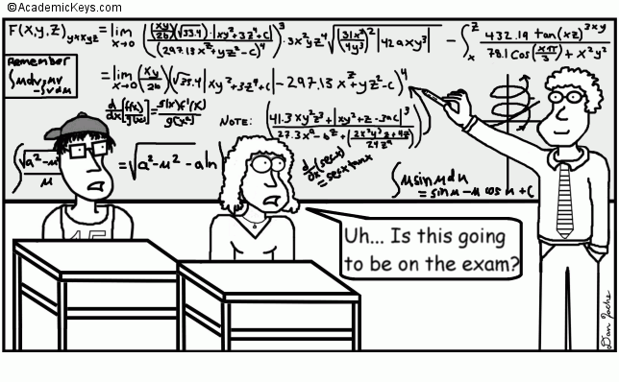
Now, any questions …?

Slide 21
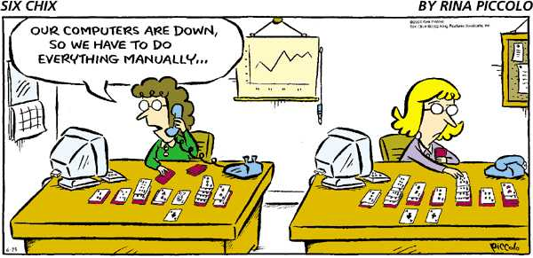
Now let’s play with it …

